Slide 1

Institute of Aeronautical Engineering
(Autonomous)
Department of Electronics and Communication Engineering
SMART GAS REGULATOR USING SENSORS
Batch Members
19951A04M6 – Mettu Vishnu Vardhan.
19951A04L8 – Penaka Venkat Sai Nishok Reddy.
19951A04M2 – Momula Vikas.
Supervisor Name
Mrs. Doma Sreelakshmi
Assistant professor
Electronics and Communication Engineering
Date: 27/12/2021

Slide 2

Introduction
L.P.G leakage occurs when the faulty regulation, poor handling of the gas appliances and poor monitoring of the LPG cylinder.
This may lead to the factors of occurring these type of disaster.
This gas leakage when caught with air it becomes highly flammable and potentially explosive.
This level of disaster can convert anything into ashes in a radius of 50 meters.

Slide 3
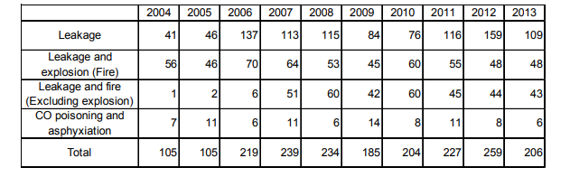
History of this disaster(Gas leakage)
Over the years, the rate of this disaster occurrences are increasing without any sign of decrement.
So to overcome this occurrences to slow down the rate we have developed this new…
“LPG leakage detection with the help of S.G.R”

Slide 4


ABSTRACT
GSM Based LPG Weight and Leakage Detection System, has application in Home, Hotels, Restaurants & Industries.
This design of this regulator provides an alert for the user by detecting the weight of the gas by “ Load Cell ” and the leakage of the gas by
“ MQ-6 ” gas sensor.

Slide 5
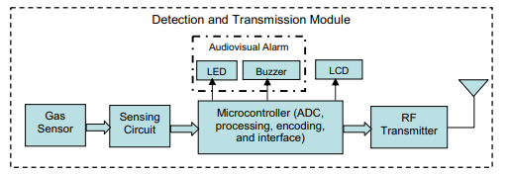
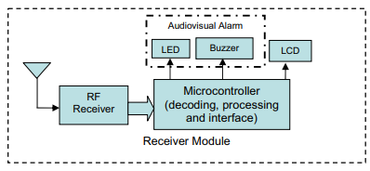
LITERATURE SURVEY :
[1] . A Wireless Home Safety Gas Leakage Detection System :-
By : Luay Fraiwan, Khaldon Lweesy, Aya Bani-Salma, Nour Mani :
The receiver module is a mobile unit that could be placed anywhere within the premises of the house so that the alarm can be detected and heard at a distance from the place of gas leakage. A block diagram for the proposed system is shown in figure.
The sensor needs to be heated to function properly, which is done through a heating element of a fixed resistance (RH). This means that the sensor should be switched on for a specific period of time before measurements are made. The heating power supply is done through the same power supply of the sensing circuit.
The sensors in this literature are so good at sensing gas and determining its ranges.
Alerts to our mobile will be the further step for this system.
As this literature states that “Further improvement can be introduced to the system by including a temperature measurement system to be used for temperature compensation, which can be done through the microcontroller to reduce the number of false positives and false negatives.” so this device do not consists of any blocking mechanism.

Slide 6
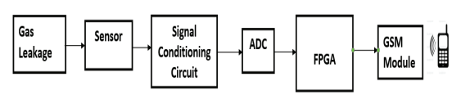
LITERATURE SURVEY :
[2] . FPGA-GSM based Gas Leakage Detection System:-
By : Arpitha .T1 , Divya Kiran, V. S.N. Sitaram Gupta and Punithavathi Duraiswamy2:
The sensor’s output is an analog resistance. The change in resistance is converted into a voltage by means of a signal conditioning circuit. In this case, a Wheatstone’s bridge along with an operational amplifier is used to convert the change in resistance to voltage. The operational is used to linearize the bridge output.
The circuit diagram of the operational amplifier based signal conditioning circuit is shown in Fig. An 8-bit ADC converts the sensor analog voltage into digital. In FPGA, the data from the ADC is measured and compared with a threshold. If a leakage is detected, a decision is made to initiate a call by reading the mobile number stored in a memory and sending it to the GSM module. An Universal Asynchronous Receiver/Transmitter (UART) is used as an interface between the FPGA and GSM module for sending the data .
Here additional ADC circuit and FPGA ,URAT interface makes the system more complex .
As the discussed factors are integrated in an simple micro-controller called ‘Arduino – UNO’.

Slide 7
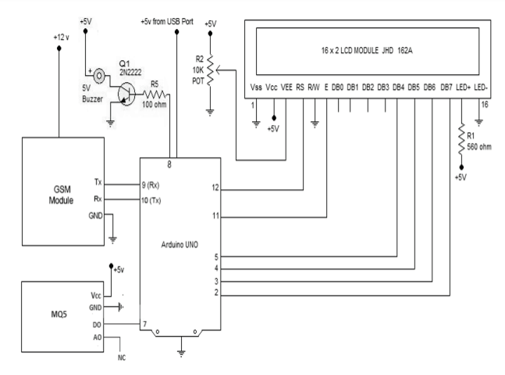
LITERATURE SURVEY :
[3] . Microcontroller Based Low Cost Gas Leakage Detector with SMS Alert :-
By : Mr. Arijit Banik, Mr. Bodhayan Aich, Mr. Suman Ghosh :-
This is used to Detect Gas Leakage (like LPG, Butane, Methane) or any such petroleum based gaseous substance that can be detected using MQ-5 Sensor.To setup an SMS based Alert Mechanism and send 3 SMS (3 alert messages) to 2.
Specified mobile numbers (input inside the Arduino Program). To produce a alarm sound upon gas leak and stop the alarm once gas leak is under control. Display status in an LCD using a 16×2 LCD module.

Slide 8
LITERATURE SURVEY :
This is used to Detect Gas Leakage (like LPG, Butane, Methane) or any such petroleum based gaseous substance that can be detected using MQ-5 Sensor.To setup an SMS based Alert Mechanism and send 3 SMS (3 alert messages) to 2.
Specified mobile numbers (input inside the Arduino Program). To produce a alarm sound upon gas leak and stop the alarm once gas leak is under control. Display status in an LCD using a 16×2 LCD module.
With the help of step down transformer of 230V AC primary to 0-12V, 500mA secondary power supply is taken from main supply. Full-wave rectifier and a capacitor filter provide the output voltage and then fed to 5-volt regulator (LM7805) whose output is used as power supply for IC’s and microcontroller.
Furthermore, temperature sensor and gas sensor is connected to the microcontroller. The Complete Connection Diagram consists of the Microcontroller Circuit, GSM Module, Power Supply, GAS Sensor Module and Exhaust Fan. The Power Supply is fed to the GSM Module. The output of the sensor goes low as soon as the MQ-5 Gas Sensor senses any gas leakage from the storage.
This is detected by the microcontroller and the LED & buzzer are turned ON. After the delay of a few milliseconds, the exhaust fan is also turned ON for throwing the gas out and the microcontroller continues sending message as “GAS LEAKAGE” to a pre-defined mobile number using GSM Module.

Slide 9
PROBLEM FOUND
Gas leakage phenomena can instantly cause fire which may lead the probability occurrence of this disaster more.
So far we used only gas sensor , which may not detect any fire.
Enhancement in Buzzer and Indicator is not found.
No shutting down mechanism.

Slide 10


SOLUTION
Stopping the gas flow in case of emergency by using, Solenoid Valve (relay on/off).

Slide 11

SOLUTION
Detection of fire is done using “Flame sensor module”

Slide 12



SOLUTION (Enhancements)
Enhancement of (L.E.D)Blinking indicator.
Enhancement of Buzzer to Speaker to dump an Voice Message

Slide 13
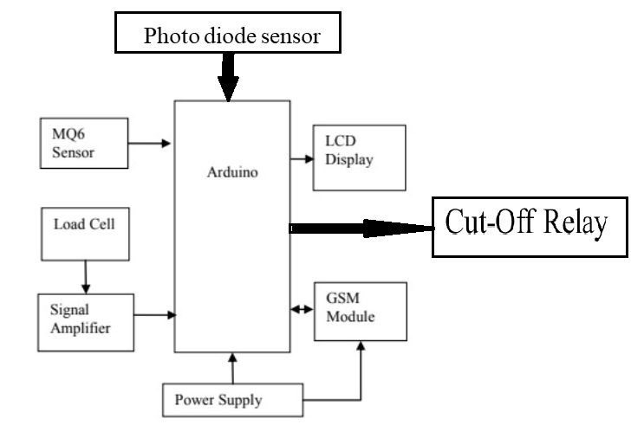
FLOW CAHRT.
Speaker
LED Strip
(Micro controller)

Slide 14
REFERENCES.
L. Fraiwan et al, "A wireless home safety gas leakage detection system," 1st Middle East Conference on Biomedical Engineering, 2011, pp. 11-14.
Arpitha, T., Kiran, D., Gupta, V. S. N. S., & Duraiswamy, P. (2016). FPGA-GSM based gas leakage detection-system.2016IEEE.doi:10.1109/indicon.2016.7838952
Luay Friwan et al, “A Wireless Home Safety Gas Leakage Detection System”, IEEE 2011.
Banik, A., Aich, B. Ghosh, S. (2018). Microcontroller based low cost gas leakage detector with SMS alert. Emerging Trends in Electronic Devices and ComputationalTechniques.doi:10.1109/edct.2018.840509.IEEE 2018.

Slide 15
THANK YOU

